Slide 1

NRI INSTITUTE OF TECHNOLOGY
DEPARTMENT OF COMPUTER SCIENCE AND ENGINEERING
B Tech 3-1
CSM Batch-22
PROJECT TITLE: COVID-19 CASES PREDICTION
BATCH MEMBERS
(20KN1A14229)
(21KN5A4255)
(20KN1A4262)
(21KN5A4202)
GUIDED BY

Slide 2
TITLE : COVID-19 CASES PREDICTION
PROBLEM STATEMENT
EXISTING SYSTEM
PROPOSED SYSTEM
SOFTWARE &HARDWARE REQUIREMENTS
CONCLUSION

Slide 3
PROBLEM STATEMENT:
My goal was to develop public models that would reasonably predict the growth of the coronavirus for the next day. This goal can be broken down and formalized into two parts:
To build a model that will predict the next day’s number of coronavirus cases based on the last n day’s number of coronavirus cases and deaths.
To build a model that will predict the next day’s number of coronavirus deaths based on the last k day’s number of coronavirus cases and deaths.
While I learned that n and k should be the same value after rigorous testing of my models, when I first defined the problem, I assumed that n and k may be different numbers as to not limit the possibilities of improving my individual models.

Slide 4
EXISTING SYSTEM:
With the outbreak of COVID-19 in 2019, which lead to many deaths and global crisis. Many service-based organisations focussed on prediction of new cases, deaths casued by COVID-19 virus for next dew days. Those organisations may include:
WHO
CDC(Centers for Disease Control and Prevention)
IHME(Institute for Health Metrics and Evaluation)
The existing system for prediction of covid-19 cases may also inculed with many government developed application in order to alert people.

Slide 5
PROPOSED SYSTEM:
ML achieved a milestone in the field of health care. ML techniques are used to interpret and analyze large datasets and predict their output. These ML tools were used to identify the symptoms of disease and classify samples into treatment groups. ML helps hospitals to maintain administrative processes and treat infectious disease.
The pandemic disease known as COVID-19 is a deadly virus that has cost the lives of many people all over the world. There is no treatment for this virus. ML techniques have been used to predict whether patients are infected by the virus based on symptoms defined by WHO and CDC.
MODELS: Support Vector Regression, BayesianRidge

Slide 6


SOFTWARE REQUIREMENTS :
PYTHON: Python is a high-level, general-purpose programming language. Its design philosophy emphasizes code readability with the use of significant indentation. Python is dynamically-typed and garbage-collected. It supports multiple programming paradigms, including structured, object-oriented and functional programming.
JUPYTER: Jupyter notebook is an open-source IDE that is used to create Jupyter documents that can be created and shared with live codes. Also, it is a web-based interactive computational environment.

Slide 7


SOFTWARE REQUIREMENTS :
PANDAS: Pandas is a software library written for the Python programming language for data manipulation and analysis. In particular, it offers data structures and operations for manipulating numerical tables and time series. It is free software released under the three-clause BSD license.
NUMPY: NumPy is a library for the Python programming language, adding support for large, multi-dimensional arrays and matrices, along with a large collection of high-level mathematical functions to operate on these arrays.

Slide 8


SOFTWARE REQUIREMENTS :
MATPLOTLIB: Matplotlib is a plotting library for the Python programming language and its numerical mathematics extension NumPy. It provides an object-oriented API for embedding plots into applications using general-purpose GUI toolkits like Tkinter, wxPython, Qt, or GTK.
Scikit-learn: Scikit-learn is a free software machine learning library for the Python programming language.[3] It features various classification, regression and clustering algorithms including support-vector machines, random forests, etc.

Slide 9
HARDWARE REQUIREMENTS:
Processor: 64 bit, quad-core, 2.5 GHz minimum per core
Ram: 4 GB or more
Hard disk: 20 GB of available space or more.
Display: Dual XGA (1024 x 768) or higher resolution monitors

Slide 10
Architecture:
Getting Data
Data Cleaning and preprocessing
Visulaization and EDA
Training Model and Testing Model
Prediction of COVID-19 cases for upcoming days

Slide 11
Every predictive models will be divided into modules for better and easy understanding and execution. The system is divided into modules such that the team work between teammates and from cilent-end will be clear. By dividing the work, errors while working on system can be identified easily.
If any system is not divided into modules and worked as a whole, then there comes a numerous errors. Even we find difficulty in correcting those errors. It is must and should to divide the total project into modules and work on each and every module independently to get effective results.
Data cleaning and Data preprocessing
Visulaization and EDA(Exploratory Data Analysis)
Training Model and Testing Model

Slide 12
DATA COLLECTION
Data collection was an essential and protracted process. Regardless the field of research, accuracy of the data collection is essential to maintain cohesion. As the clinical information of patients was not publicly available, it was an inflexible and tedious process to collect the data. Various Hospitals and Health Institutes in Sweden and China were approached to get the most accurate data but due to the present situation at hospitals with heavy inflow of patients with COVID-19, we couldn’t get access to direct information. An intense search was conducted on various databases to gather open-source clinical information of patients diagnosed with COVID-19.

Slide 13
DATASET

Slide 14
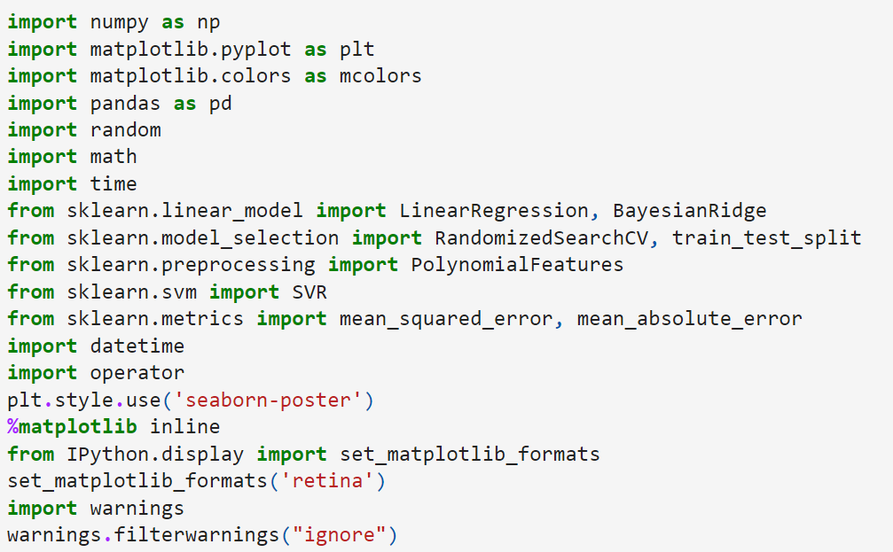
Implementation

Slide 15
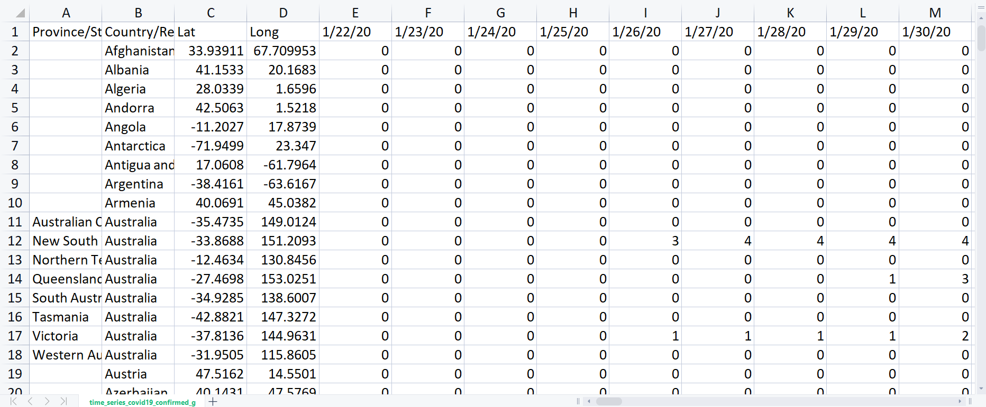
Data cleaning and Data preprocessing:
Data cleaning is the process of adding missing data and correcting, repairing, or removing incorrect or irrelevant data from a data set. Dating cleaning is the most important step of preprocessing because it will ensure that your data is ready to go for your downstream needs

Slide 16
Visulaization and EDA:
Exploratory Data Analysis (EDA) is a process of describing the data by means of statistical and visualization techniques in order to bring important aspects of that data into focus for further analysis. This involves inspecting the dataset from many angles, describing & summarizing it without making any assumptions about its contents.
Exploratory data analysis is a significant step to take before diving into statistical modeling or machine learning, to ensure the data is really what it is claimed to be and that there are no obvious errors. It should be part of data science projects in every organization.

Slide 17
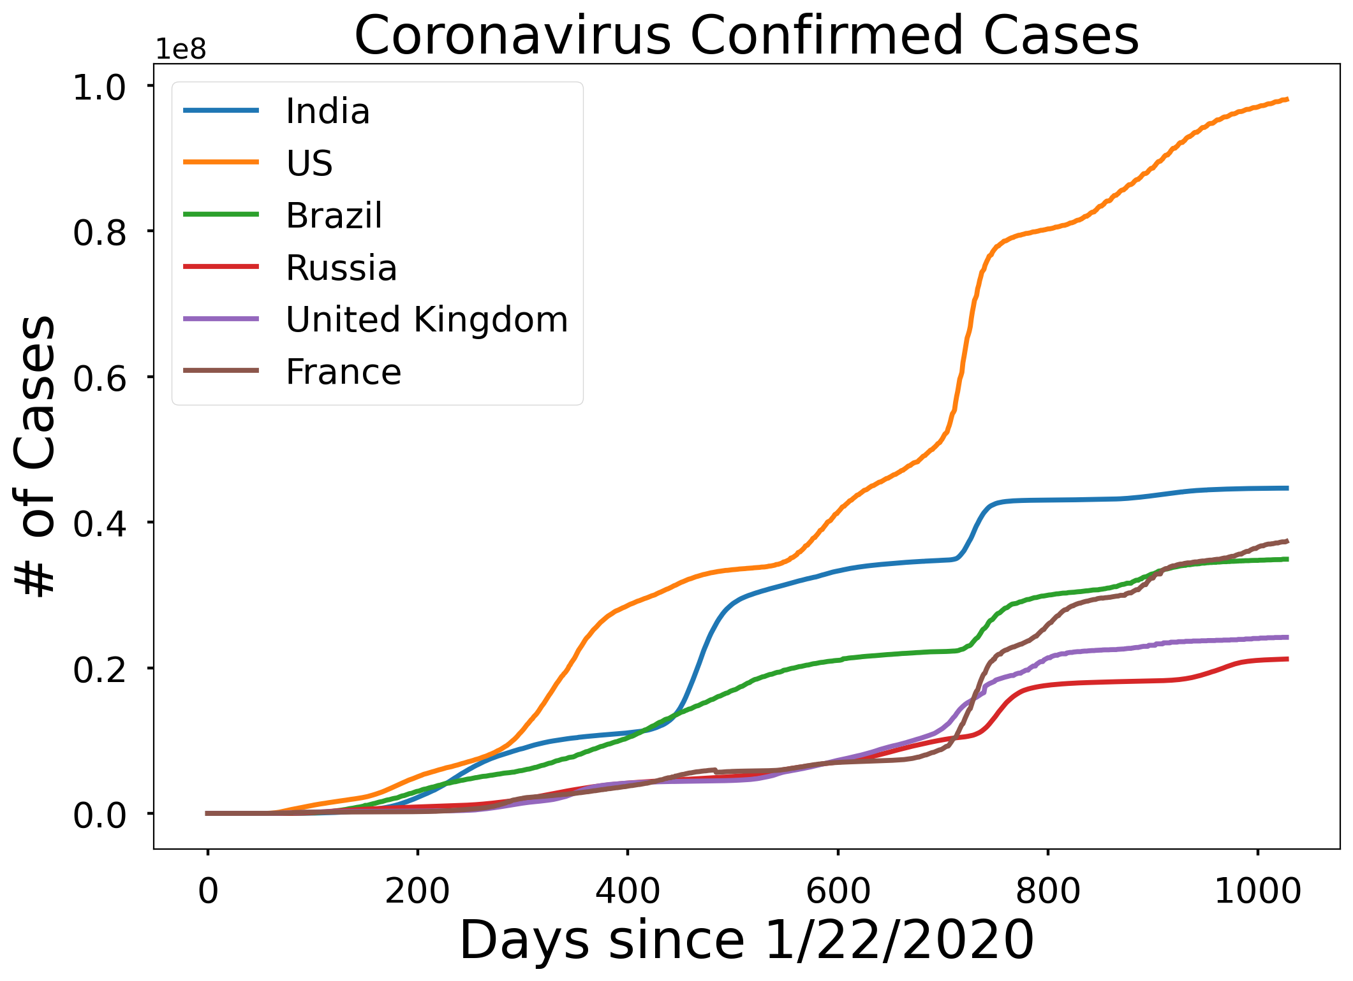
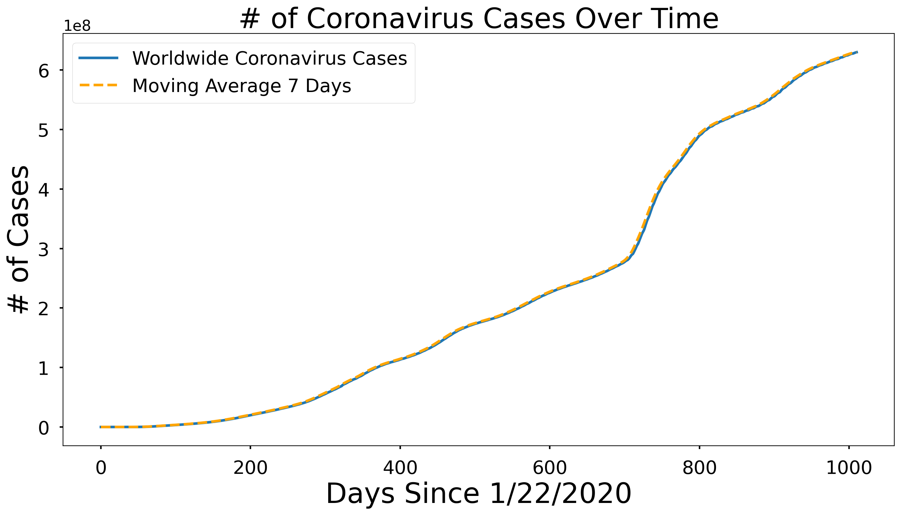
Visulaization:

Slide 18
Training and Testing Model:
Machine Learning is one of the booming technologies across the world that enables computers/machines to turn a huge amount of data into predictions. However, these predictions highly depend on the quality of the data, and if we are not using the right data for our model, then it will not generate the expected result. In machine learning projects, we generally divide the original dataset into training data and test data. We train our model over a subset of the original dataset, i.e., the training dataset, and then evaluate whether it can generalize well to the new or unseen dataset or test set. Therefore, train and test datasets are the two key concepts of machine learning, where the training dataset is used to fit the model, and the test dataset is used to evaluate the model.

Slide 19
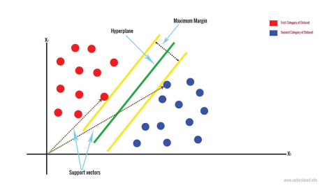
Machine Learning Models Used
Support Vector Machines (SVM)
Support Vector Machines performs classification by constructing N-dimensional hyper plane that separates the data into two categories. In SVM, the predictor variable is called an attribute and the transformed attribute is called a feature. Selecting the most suitable representative data is called feature selection. A set of features describing one case is called a vector.
The ultimate goal of SVM modelling is to find the optimal hyper plane that separates the clusters where on one side of the plane there is target variable and on the other side of the plane other category. The vectors which are near the hyper plane are the support vectors.

Slide 20
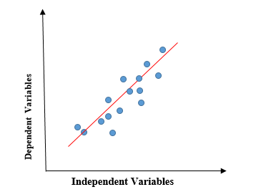
Machine Learning Models Used
Linear Regression
Linear regression is a quiet and simple statistical regression method used for predictive analysis and shows the relationship between the continuous variables. Linear regression shows the linear relationship between the independent variable (X-axis) and the dependent variable (Y-axis), consequently called linear regression. If there is a single input variable (x), such linear regression is called simple linear regression. And if there is more than one input variable, such linear regression is called multiple linear regression. The linear regression model gives a sloped straight line describing the relationship within the variables.

Slide 21
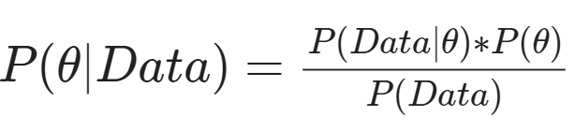
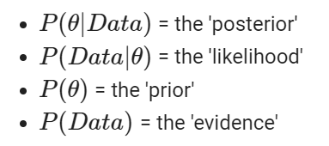
Machine Learning Models Used
Bayesian
Bayesian inference is a method to figure out what the distribution of variables is (like the distribution of the heights h). The interesting feature of Bayesian inference is that it is up to the statistician (or data scientist) to use their prior knowledge as a means to improve our guess of how the distribution looks like.
Bayesian inference depends on the principal formula of Bayesian statistics: Bayes’ theorem. Bayes’ theorem takes in our assumptions about how the distribution looks like, a new piece of data, and outputs an updated distribution. For data science, Bayes’ theorem is usually presented as.

Slide 22
Testing
We are about to test the Machine Learning code for Covid-19 cases prediction in demo part.

Slide 23
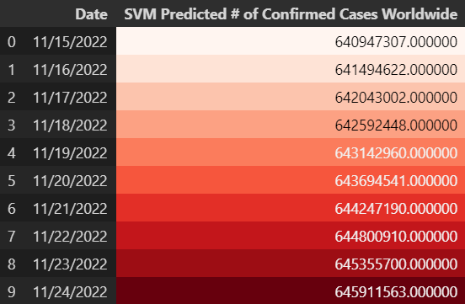
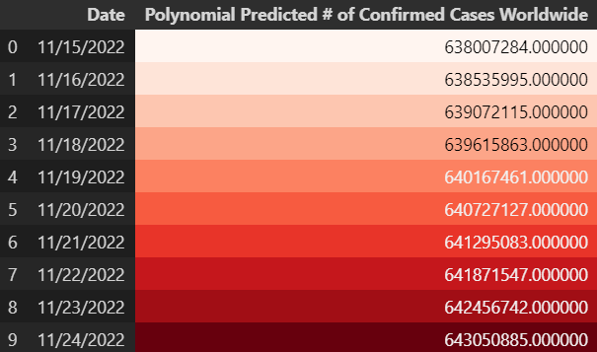
Output:

Slide 24

Output:

Slide 25
CONCLUSION:
We have proposed a method that generates predictions for the number of COVID-19 infectious disease cases in the future.It is believed that the performance of the model can be improved or the model can give more accurate data if more datasets are available. The model gives results on the basis of data developed by information given by health agencies. Thus, forecasting may not be 100% accurate, but it can surely be used as a corrective measure. For future work further enhancement can be done by combining new factors and algorithms with ARIMA to get more accurate results.

Slide 26
THANK YOU

